Slide 1
ANN (Artificial Neural Networks)
Oleksandr Trunov
(Source: Video from http://superdatascience.com/ on Udemy.com „Deep Learning A-Z™“)

Slide 2
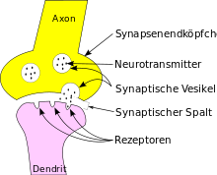
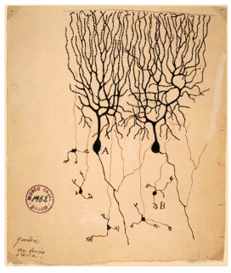
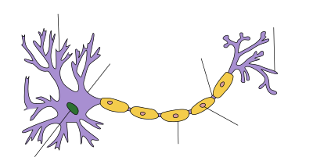
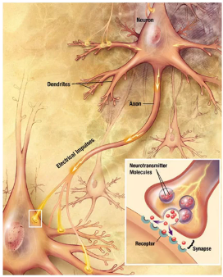
The Neuron
Dendrites (receiver of the signal)
Axon (transmitter of a signal)
Drawing of neurons in the pigeon cerebellum, by Spanish neuroscientist Santiago Ramón y Cajal in 1899.
Neuron

Slide 3
The Neuron
Input value 1
a1
a2
neuron
Input value 2
y
Output value
Input value 3
a3
Input value m
m
Synapse
Same observation

Slide 4
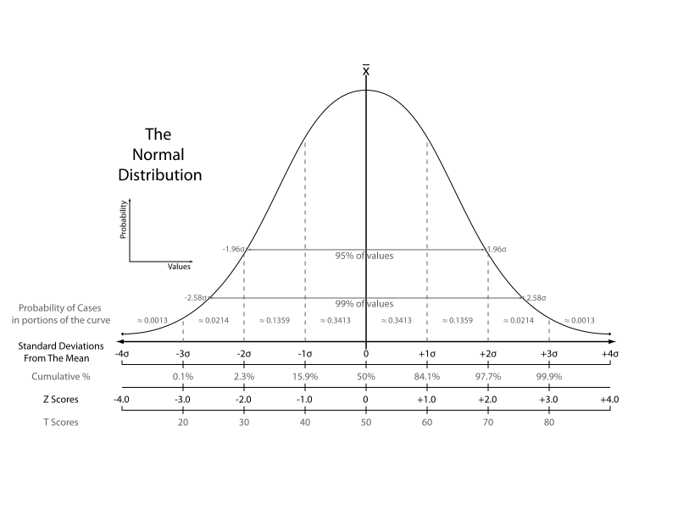


The Neuron / Input value
Standard score:
Z-Transformation (-1 to 1)
Normalisierung:
Min-Max-Scaling Method (0 to 1)

Slide 5


The Neuron / Output value
y
a1
vs.
y^
w1
a2
w2
neuron
Can be:
Continuous (price)
Binary (yes / no)
Categorical
Regression problem
y^
w3
a3
m
y^
m
Synapse
Activation function
y^
y^

Slide 6
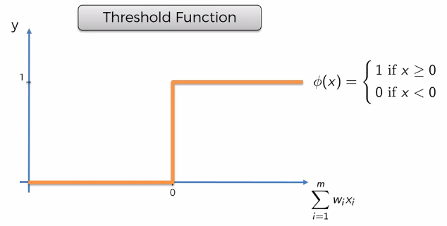
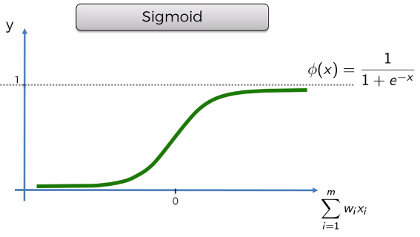
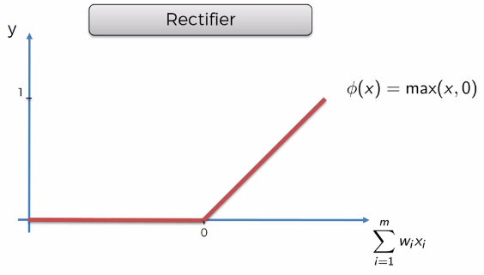
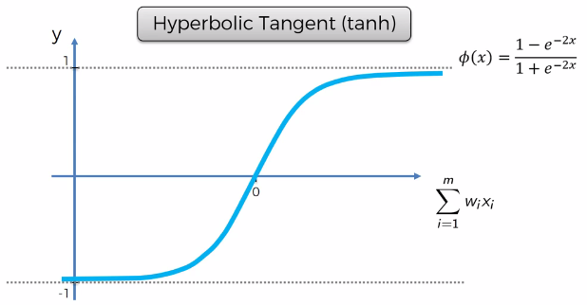
Activation function

Slide 7
a1
Age
a2
Sex
…
More as 1 hidden layer
y^
Grad
a3
Index
Result
y
a_{m}
Forward propagation
Input Layer
(attribute)
Hidden Layer
Output Layer (prediction)

Slide 8
How do ANN work
a1
Area (sqm)
w1
Price = w1*a1 + w2*a2 + wm * am
a2
w2
neuron
Location
y^
w3
a3
Bedrooms
C
m
y
y^
y^
y^
Age
m
Synapse
y
y
+
+
=
Row 1
Row 2
Row 2

Slide 9
Not all neurons are connected (not all attributes are important for each neuron in hidden layer)
If the attribute is important – “synapse / axon” has a big weight (0 < w₁…w_{m} <= 1)
a1
Activation function (for example:
Threshold Function (1 or 0)
Sigmoid (probability (from 0 to 1))
Rectifier (non-linear)
Hyperbolic Tangent (same how Sigmoid, but from -1 to 1)
Age
a2
Sex
y^
Activation function too
…
More as 1 hidden layer
Grad
a3
y^ -> prediction
y -> actual value
Implement Cost Function (Principe of means squared error)
For example: C = 0.5*(y^-y)² -> min
We compare prediction and actual value and look for a diff between them. We try to reduce (min-problem) a difference between them (backpropagation)
Index
Result
y
a_{m}
Forward propagation
Backpropagation -> Adjust w1 … w_{m}
Input Layer
(attribute)
Hidden Layer
Output Layer (prediction)

Slide 10
Data Set:
Age
Sex
Grad
Index
Result
Row 1
12
w
s
129
B
Row 2
11
m
s
111
F
a1
Row 3
14
w
s
135
A
Epoch: “One Epoch is when an ENTIRE dataset is passed forward and backward through the neural network only ONCE.”
Batch: After each Batch -> backpropagation
Interaction: “Iterations is the number of batches needed to complete one epoch.”
Age
a2
Sex
…
More as 1 hidden layer
y^
Grad
a3
Index
Adjust w1 … w_{m}
Result
y
y
C
a_{m}
y^
y^
y^
y
y
+
+
=
Row 1
Row 2
Row 2
Input Layer
(attribute)
Hidden Layer
Output Layer (prediction)

Slide 11
Gradient Descent
C
y^

Slide 12
Stochastic Gradient Descent
C
Not convex
Backpropagation function is false
Best option!
Local minimum
y^

Slide 13
Batch Gradient Descent:
Find local min of cost function
TRADE OFF!
Age
Sex
Grad
Index
Result
Row 1
12
w
s
129
B
Row 2
11
m
s
111
F
Update weight
Hybrid:
Row 3
14
w
s
135
A
Age
Sex
Grad
Index
Result
Row 1
12
w
s
129
B
Stochastic Gradient Descent:
Row 2
11
m
s
111
F
Find global min of cost function
Row 3
14
w
s
135
A
Age
Sex
Grad
Index
Result
Row 1
12
w
s
129
B
Update weight
Row 2
11
m
s
111
F
Update weight
Row 3
14
w
s
135
A
Update weight

Slide 14
Training steps with stochastic gradient descent:
Randomly initialize the weights to small numbers close to 0, but not 0 (for example 0.1)
Input the first observation of your dataset in the input layer, each feature in one input node
Forward-Propagation: left -> right, output is y^
Compare the predicted result (y^) to the actual result. Measure with the cost-function
Backpropagation: right -> left, update of weights
Repeat steps 1 to 5 and update the weights after each observation or after each batch of observation
When the whole training set passed through the ANN -> it is an epoch. Make more epochs

Slide 15
Knowledge Discovery and Data Mining Framework (KDDM)
AP 1
Business Understanding
Data Understanding
Planung und technische Vorbereitung
AP 2
Data Preparation
Deployment
Modelling
AP 3
Evaluation
AP 4

Slide 16
Let’s go to write code!

